Slide 1



UK Train Rides: Operational Performance Analysis
Presenter: Mazen (Team Leader)
Date: 4/4/2025

Slide 2
Project Idea
This project delves into the operational performance of UK train rides using Power BI. Our team, the Insight Hunters, aims to provide actionable insights into service efficiency, delay causes, customer behavior, and financial impacts. We've developed key dashboards to answer analytical, strategic, and operational business questions, employing tools like Power Query and DAX.
Our findings aim to support decision-making processes by identifying areas for performance improvement, cost reduction, and enhanced customer satisfaction. Join us as we explore the data and uncover valuable insights to optimise UK train services.

Slide 3
Project Idea
Project Background
Problem Statement
Objective
The project addresses the increasing complexity of UK train operations. Rising customer expectations and operational challenges necessitate leveraging data analytics to improve train services.
The primary issue is inefficiency in train operations, including delays, revenue losses, and factors affecting customer satisfaction and operational costs.
The goal is to analyze delay causes, trip distributions, financial losses, and customer preferences to enable better resource allocation and service optimisation.

Slide 4
Project Wireframe
Analytical Dashboard
Strategic Dashboard
Focuses on customer and sales insights, providing an overview of trip volume, delay reasons, ticket class distributions, and revenue trends.
Highlights business performance and customer experience, including station performance and revenue trends.
Operational Dashboard
Monitors real-time efficiency metrics, delay trends, and financial impacts to improve operational performance.

Slide 5
End Users & Features
Primary User Personas:
User Persona | Focus Area
Train Company Executives | Profitability, delay costs
Operations Managers | Train schedules, delays
Customer Experience Teams | Customer satisfaction, refunds
Passengers (indirect) | Service quality, reliability

Slide 6
End Users & Features
Key Features:
Financial KPIs (Total Delay Cost, Avg Cost per Delay)
Delay Analysis (Reasons for delays, delay frequencies)
Ticket Class Insights (Standard vs. First Class sales)
Trips Monitoring (Trip status and operational updates)
How Features Solve Problems:
Executives: Control costs and improve budget planning.
Operations Managers: Reduce delay causes and optimize schedules.
Customer Experience Teams: Tailor services and promotions based on customer behavior.
Passengers: Enjoy better service with fewer disruptions.

Slide 7
Data Structure
Database Architecture:
Type: ➔ Relational Database (Star Schema) ➔ Built inside Power BI using Fact and Dimension Tables.
Why Relational? ➔ To ensure efficient querying, clear relationships, and scalable reporting.

Slide 8
Data Structure
Fact Table:
(Fact Transactions) Contains trip-level records like ticket sales, delays, prices
Dimension Tables:
Dim Ticket (Ticket Class, Ticket Type)
Dim Buying Process (Purchase Type, Payment Method)
Dim Route (Departure and Arrival Stations)
Dim Railcard (Railcard information)
Dim Calendar (Date details for analysis)
Relationships: ➔ Fact Transactions is linked to each dimension using foreign keys (surrogate IDs). ➔ Classic one-to-many relationships (one ticket class → many trips, one station → many trips, etc.)

Slide 9
Data Structure
Data Flow:
Data Source: ➔ CSV files containing railway transactions.
Data Collection & Preparation: ➔ Loaded into Power BI through Power Query.
Data Cleaning Techniques: ➔ Corrected data types (dates, numbers). ➔ Filled missing "Reason for Delay" as "No Delay" for on-time trips. ➔ Managed nulls for canceled trips in arrival times. ➔ Removed duplicate records for data integrity.
Data Shape: ➔ Fact Table: 1.8M+ rows (large dataset) ➔ Balanced: Dataset is slightly imbalanced (majority trips are on time; fewer delayed/canceled trips).
Model Storage: ➔ Stored as a Power BI project file (.pbix) with optimized tables for high-performance dashboards.

Slide 10
Programming Languages + Frameworks
Programming Languages:
DAX (Data Analysis Expressions): ➔ Used for creating custom measures and calculations in Power BI.
M Language (Power Query Formula Language): ➔ Used for data transformation and cleaning inside Power BI.
Frameworks / Tools:
Power BI Desktop: ➔ Main platform for building dashboards, visualizations, and reports.
Power Query Editor: ➔ Used for ETL (Extract, Transform, Load) processes (data cleaning, shaping, loading).
Power BI Data Modeling: ➔ For building the Star Schema and relationships.

Slide 11
Programming Languages + Frameworks
Supporting Technologies:
CSV Files: ➔ Source data format used for the project.
Star Schema Architecture: ➔ For efficient relational data modeling.
Microsoft Power BI Services (Optional if published): ➔ For sharing and deploying dashboards online (only if you published it).

Slide 12
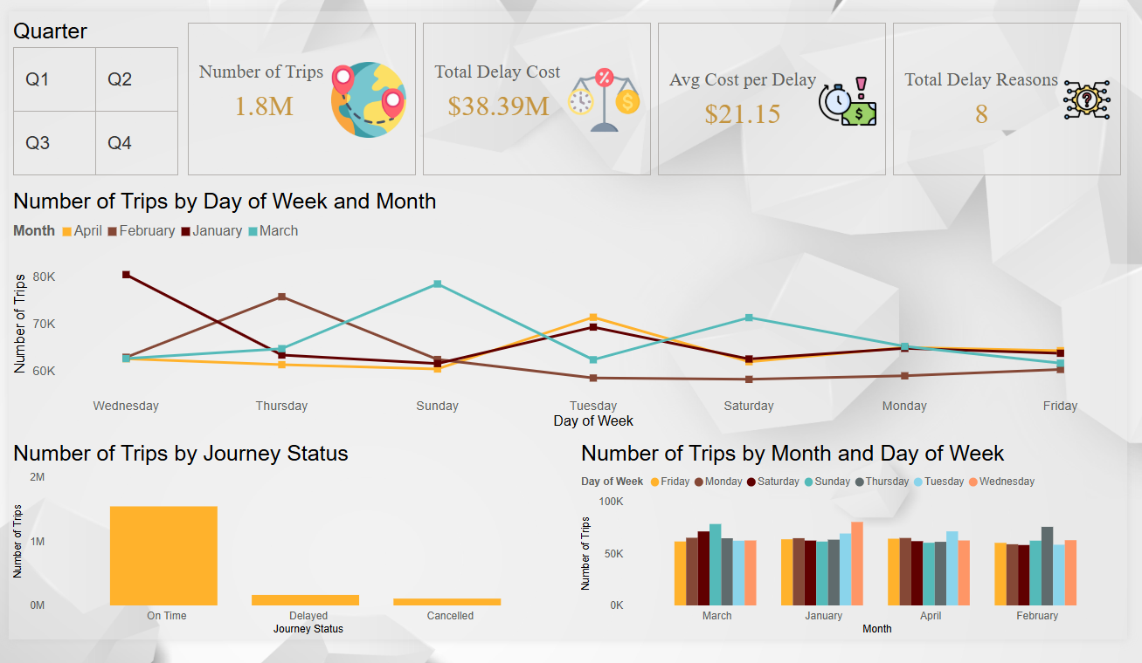
Deliverables
Reports & Documentation:
Technical Report: ➔ Detailed project overview, problem statement, objectives, methods, and findings.
Power BI Dashboards: ➔ Analytical, Strategic, and Operational dashboards for UK Train Rides.
Data Cleaning & Modeling Documentation: ➔ Steps taken for data preparation (Power Query, Star Schema design).
Power BI Measures Documentation: ➔ Full list of DAX calculations used.

Slide 13
Project Team + Roles
Core Team Members & Roles:
Mazen Moustafa Sayem Abdel-tawwab ➔ Team Leader – Reporting and Documentation
Shahd Noman Esawy Esawy ➔ Operational Dashboard Developer
Asmaa Salah Mohamed Alhady ➔ Executive Dashboard Developer
Abdallh Mohamed Abdelmonem Soliman ➔ Home Page and Recommendation Designer
Saif Mohammed Godah ➔ Analytical Dashboard Developer
Key Responsibilities:
Creating specialized dashboards (Operational, Executive, Analytical).
Designing the Home page and final Recommendations section.
Writing the Technical Report and project Documentation.
Ensuring alignment between design, analysis, and reporting.
Communication Tools: WhatsApp, GitHub, Google Drive, Zoom

Slide 14
Thank You !
Contact Information: Team leader Mazen Moustafa
Email : mazen110.net@gmai.com
Phone: +20 155 565 7877

